Slide 1
Today
Big theory around second language acquisition (45 min.)
Federal ESEA framework (45 min.)
Common Core Standards (1 hr.)

Slide 2
Big Theory
Nature v. nurture.
Acquisition, development, learning.
Modularity (language v. cognition).
Individual v. social.

Slide 3
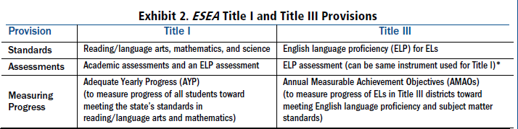
ESEA: Title I and Title III

Slide 4
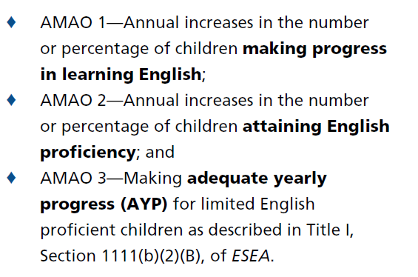
AMAO

Slide 5
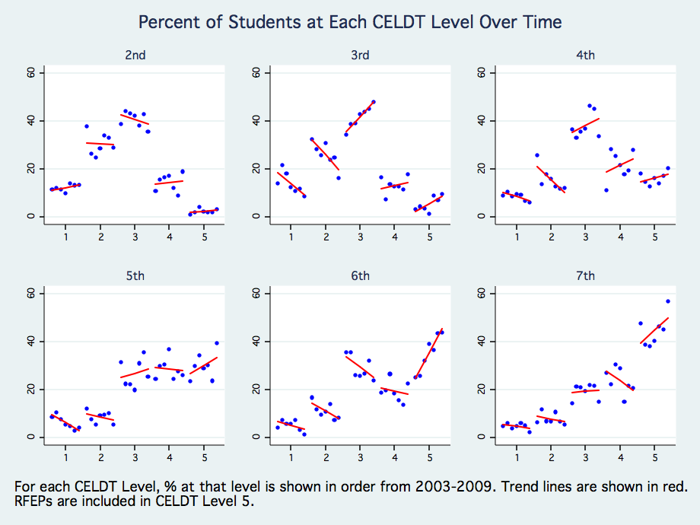
Showing Growth in English Language Proficiency Development
Notes:
Time expectations for English proficiency development is key, and policy either ignores this, or has unrealistic expectations, such as that kids should learn English in one year. This is not realistic. Data solidly show that even in the best-performing of districts, it takes five or more years for most ELLs to attain proficiency in English. Look at these data from Sanger. It is not until the 5th grade that most of the ELLs are in the higher levels of English proficiency. So, we think that 5 years is a realistic but ambitious expectation for most school districts, and that policy should drive toward this expectation.

Slide 6
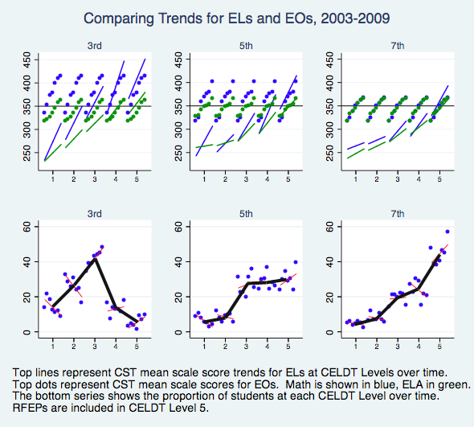
Narrowing the EL-EO Gap

Slide 7
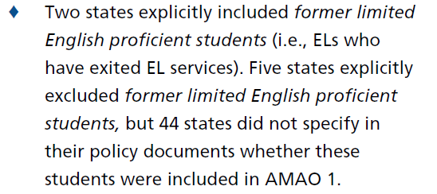
Messy Implementation

Slide 8
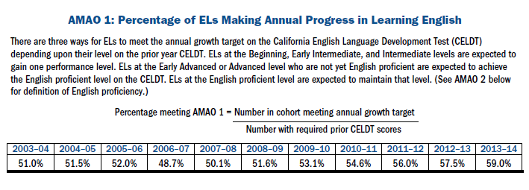
AMAO 1

Slide 9
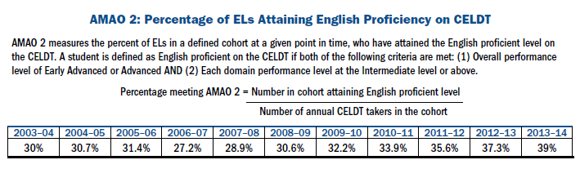
AMAO 2

Slide 10
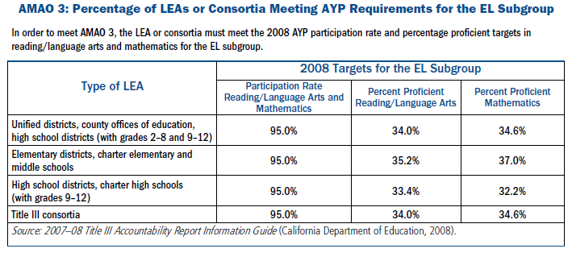
AMAO 3

Slide 11
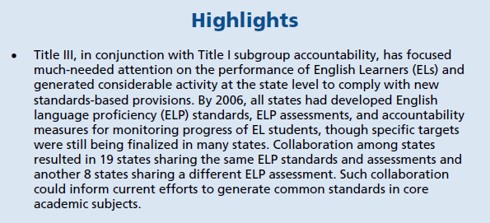

Slide 12
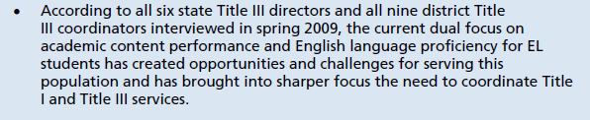

Slide 13
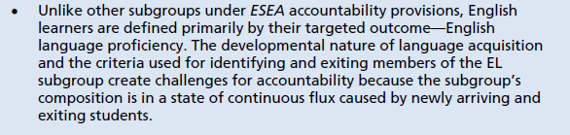

Slide 14
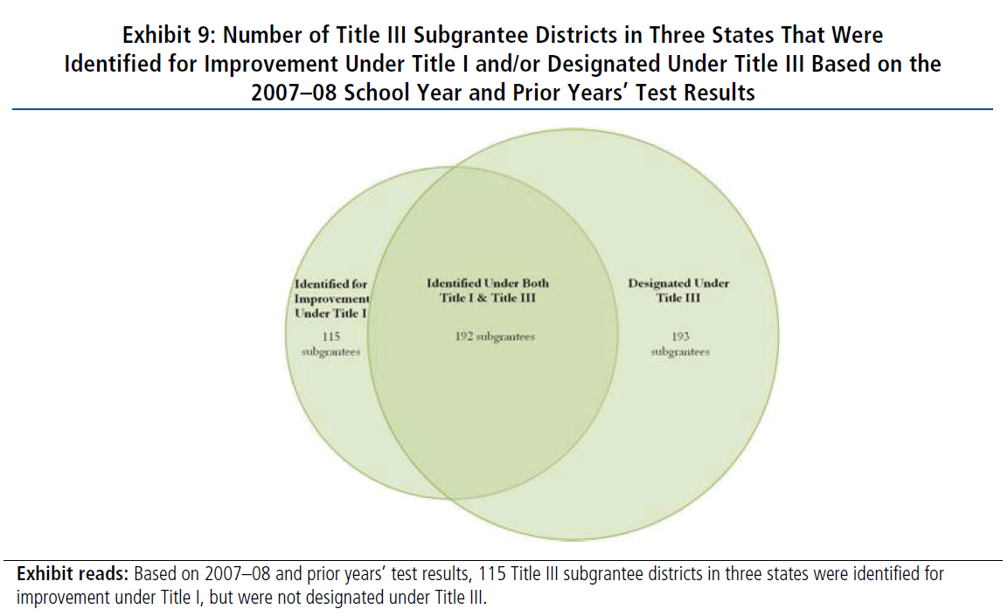
Title I and/or Title III

Slide 15
Federal and state policy framework.
How does federal law and policy address the needs of English language learners (ELLs)?
How do the policies reflect the distinction between language acquisition and cognitive development for English language learners?
What is the accountability framework with respect to the academic development of ELLs?
What potential influence does the Common Core Standards have on standards, instruction, and expectations for ELLs with respect to their acquisition of English?

Slide 16
Next Week: Linguistic Theory
How has linguistic theory treated differences between languages?
What implications does the theoretical stance have on our understanding of second language learners?
Does the first language matter in the acquisition of the second language?
Readings: Deutscher, start Lightbown.

